Slide 1
“On the way with Python”

Slide 2
Python Variables
Lecture
02

Slide 3
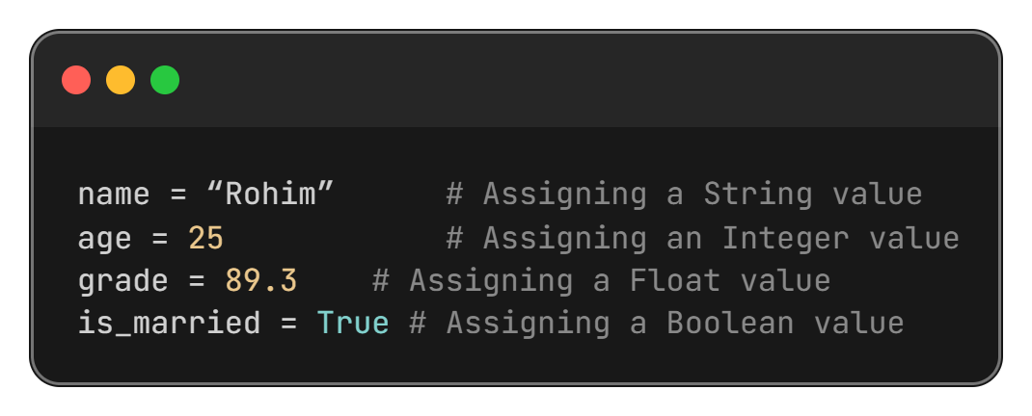
What is Variable?
A variables are containers for storing data values. The value of a variable can be changed during program execution.

Slide 4
Why use Variable?
Variables are used to:
Store data
Reuse values
Make programs readable and manageable
Perform calculations easily

Slide 5
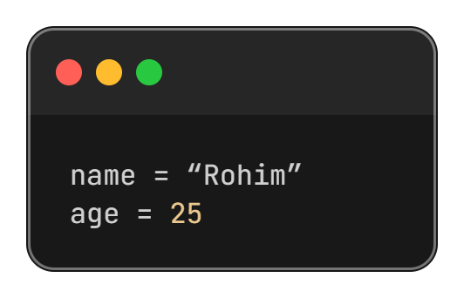
Variable declaration in Python
Python automatically determines the data type based on the value.

Slide 6
Rule of Naming Variables
An identifier can only contain alphanumeric characters (a-z, A-Z, 0-9) and underscores (_). It cannot start with a digit.
Python is case-sensitive, so myVar and myvar are different identifiers.
Identifiers cannot be a reserved keyword.
There is no limit on the length of an identifier, but it's recommended to keep it concise and meaningful.

Slide 7
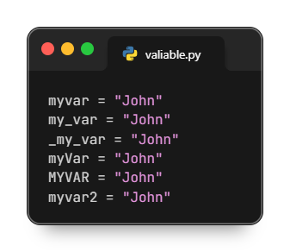
Valid Variables

Slide 8
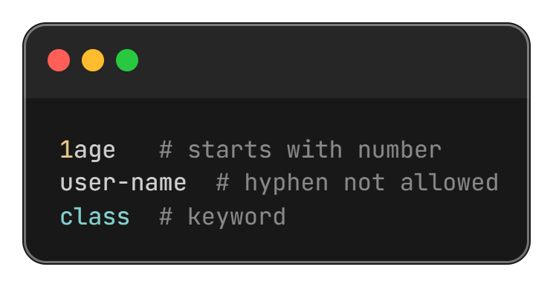
Invalid Variables

Slide 9
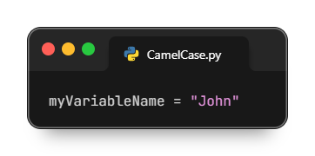

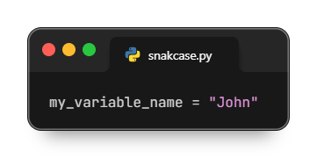
Multi Word Variable Names
Camel Case:
Each word, except the first, starts with a capital letter:
Pascal Case:
Each word starts with a capital letter:
Snake Case
Each word is separated by an underscore character:

Slide 10
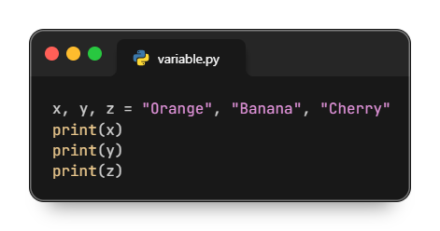
Many Value to Multiple Variables
Note: Make sure the number of variables matches the number of values, or else you will get an error.

Slide 11
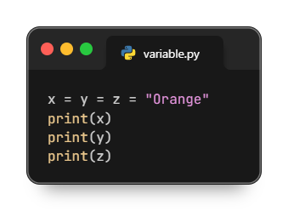
One Value to Multiple Variables

Slide 12
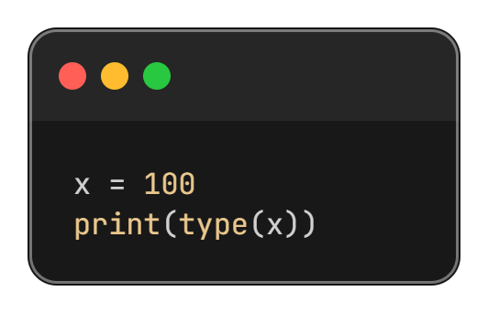
Checking Variable Type

Slide 13
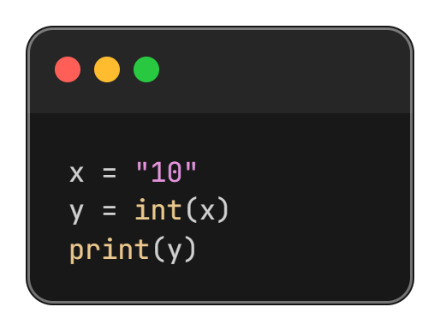
Variable Type Casting
Converting one data type to another

Slide 14
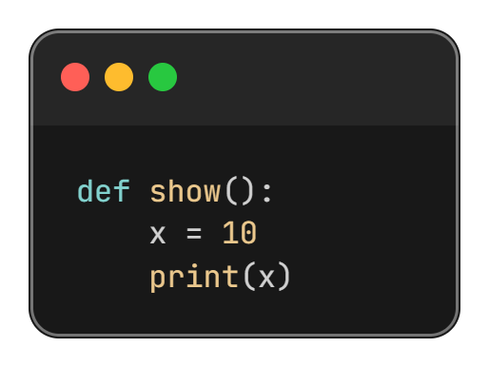
Local Variables
Defined variable inside a function

Slide 15
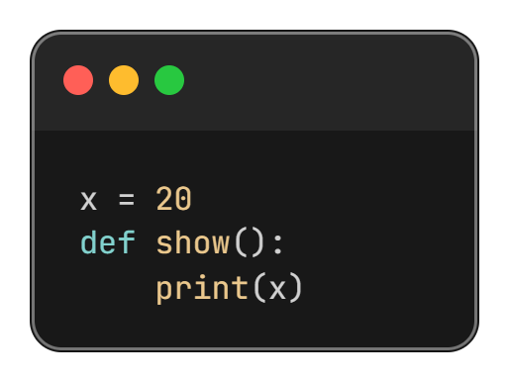
Global Variables

Slide 16
Global Variables
Global variables can be used by everyone, both inside of functions and outside.
Variables that are created outside of a function are known as global variables.

Slide 17
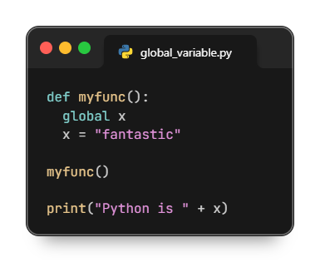
Global Variables by Global Keyword
If you use the global keyword, the variable belongs to the global scope:

Slide 18
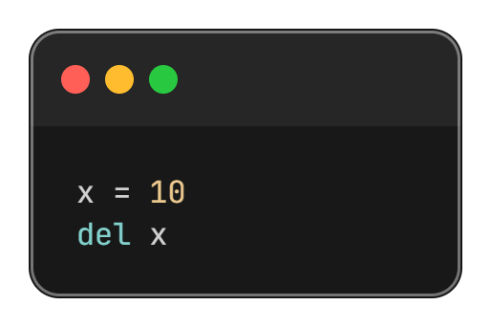
Deleting a Variable

Slide 19
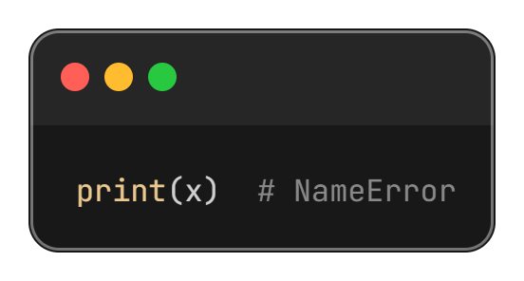
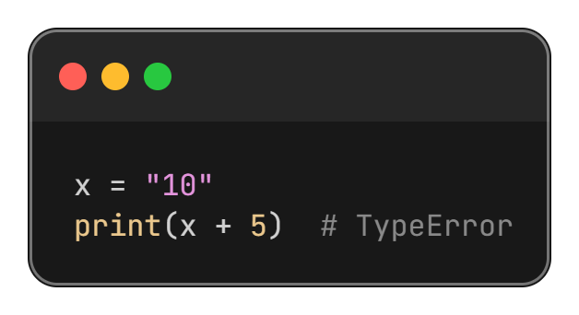
Common Errors with Variables
Wrong type usage
Using undefined variable

Slide 20
““Thanks All””

